Slide 1

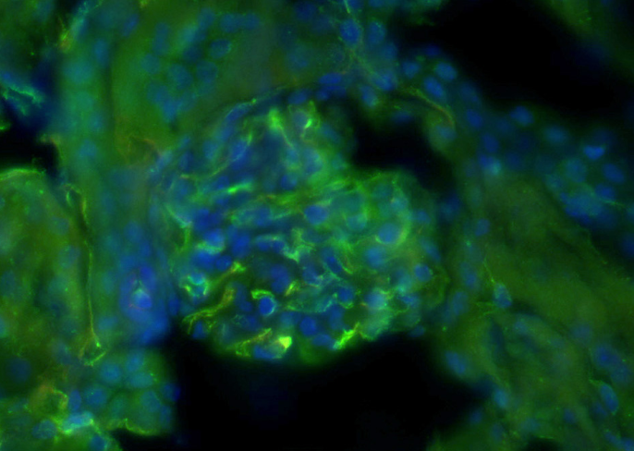
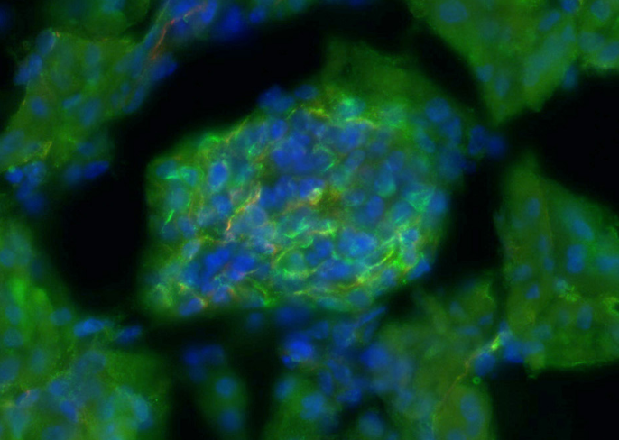
ReliaTech GmbH
Rabbit anti-mouse Endomucin
(Cat #103-PA49AG)
K22973
K22974
Immunofluorescence staining (green) of cryo-sections of adult mouse kidney (fixed 15 min in 4% PFA) with anti-mouse Endomucin (5µg/ml) [Cat# 103-PA49AG] and counter staining of nuclei with Dapi.
The experiment was performed by the research group of Prof. Dr. J. Wilting and Dr. K. Buttler, University Göttingen, Germany.
http://www.reliatech.de / orders@reliatech.de

